Slide 1
Graph
Convolutional
Reinforcement
Learning
CS 399
Seminar - Cognitive Computing

Slide 2
DISCUSSION POINTS
Overview
Reinforcement Learning
Multi-agent RL
Importance of MARL
SOTA Algos (MADDPG)
Graph Convolutional RL
Company Standup Meeting
02

Slide 3

REINFORCEMENT
LEARNING
Reinforcement learning (RL) is an area of machine learning concerned with how intelligent agents ought to take actions in an environment in order to maximize the notion of cumulative reward
Reinforcement learning is one of three basic machine learning paradigms, alongside supervised learning and unsupervised learning.
Reinforcement learning differs from supervised learning in not needing labeled input/output pairs to be presented, and in not needing sub-optimal actions to be explicitly corrected.

Slide 4

MULTI-AGENT RL
Amongst the various domains of Artificial Intelligence (AI) research being advanced at the moment, one domain has become critical to the broader success of artificial intelligence, while still in its infancy. It’s called multi-agent reinforcement learning.
Multi-agent reinforcement learning is the study of numerous artificial intelligence agents cohabitating in an environment, often collaborating toward some end goal.
derives inspiration from other social structures in the animal kingdom. It also draws heavily on game theory.

Slide 5

IMPORTANCE OF MARL
Multi-agent systems can be used to model many complex problems of today’s society, such as urban and air traffic control, multi-robot coordination, distributed sensing, and energy distribution.
More critical reasons for the research community to focus on multi-agent reinforcement learning: the role of sociability in increasing a species intelligence for the safe development of artificial intelligence
If we’re working toward advancing artificial intelligence, it reasonable to posit that the same sort of sociability that is so fundamental to our own intelligence will be important to advancing artificial intelligence.

Slide 6
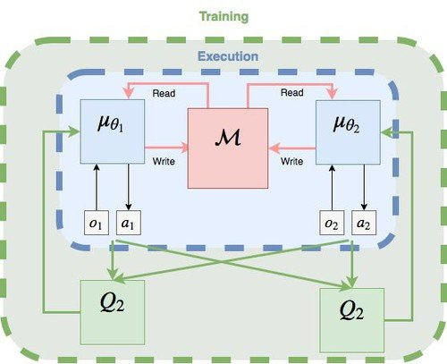
MADDPG ALGORITHM
Actor-Critic model. Wherein two separate neural networks,
one the actor and the other the critic.
An actor-network that uses local observations for deterministic actions
A critic-network that uses joint states action pairs to estimate Q-values
But in MADDPG, there is a joint critic network for all agents but individual action networks. This enables the Multi-agent system to learn a joint Q-Value
Disadvantages
But there are a few issues with this system, Namely,Communication among all agents makes it hard to extract valuable information for cooperation, while communication with only nearby agents may restrain the range of cooperation.

Slide 7
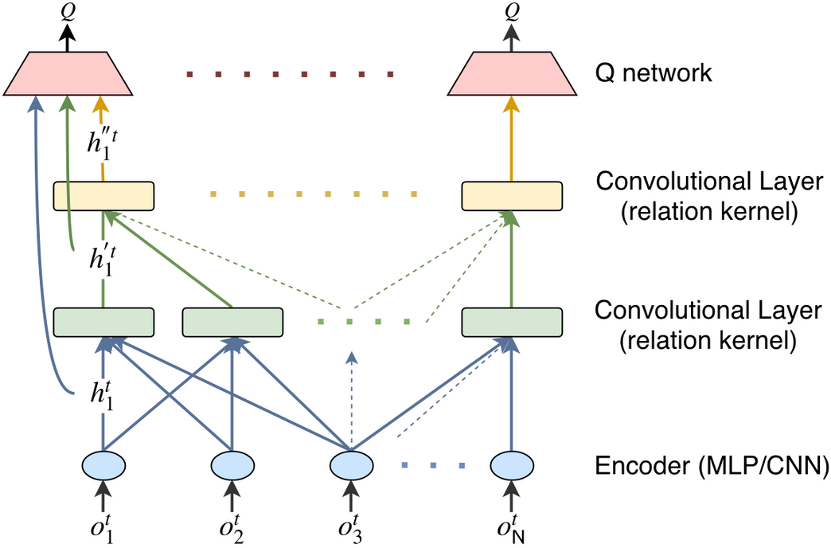
GRAPH CONVOLUTIONS
The paper proposes to model the multi-agent environment as a graph.
Each agent is a node, the encoding of local observation of agent is the
feature of the node, and there is an edge between a node and its every neighbor.
We apply convolution to the graph of agents. By employing multi-head attention as the convolution kernel.
Graph convolution is able to extract the relation representation between nodes and convolve the features from neighboring nodes.
Performance
We can see the improved performance than the state of the art models in benchmark cooperation tasks like battle, jungle, routing.

Slide 8
THANK YOU!

